Slide 1
W3C WoT Standardization
2nd W3C WoT Workshop, Munich, Germany, 4/5 June 2019

Slide 2







The Internet of Things
SILOS
CoAP
CoAP
MQTT
Modbus TCP
CoAP
HTTP / CoAP / MQTT
UA Binary
HTTP / MQTT
…

Slide 3
Counter the Fragmentation in the IoT
Describe and Complement Existing Platforms and Foster Convergence
…
…

Slide 4







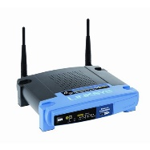
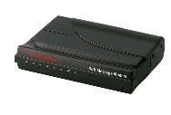
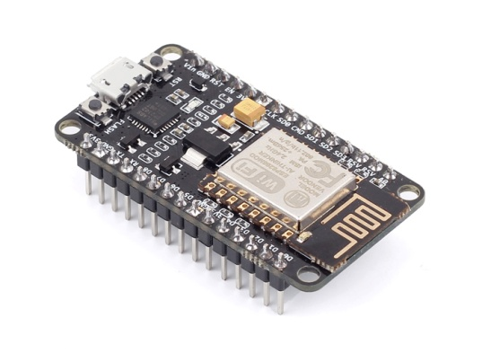
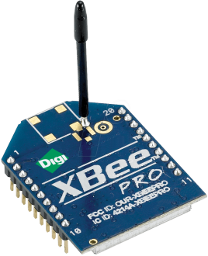

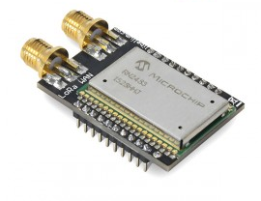


From the IoT to the Web of Things
World Wide Web (WWW)
Web of Things (WoT)
…
GEnie
Internet
Internet of Things (IoT)

Slide 5
W3C WoT Building Blocks
Properties
WoT Security Guidelines
Actions
Events
WoT Thing Description
Web Things
WoT Architecture
WoT Scripting API
WoT Binding Templates

Slide 6
WoT Architecture

Slide 7
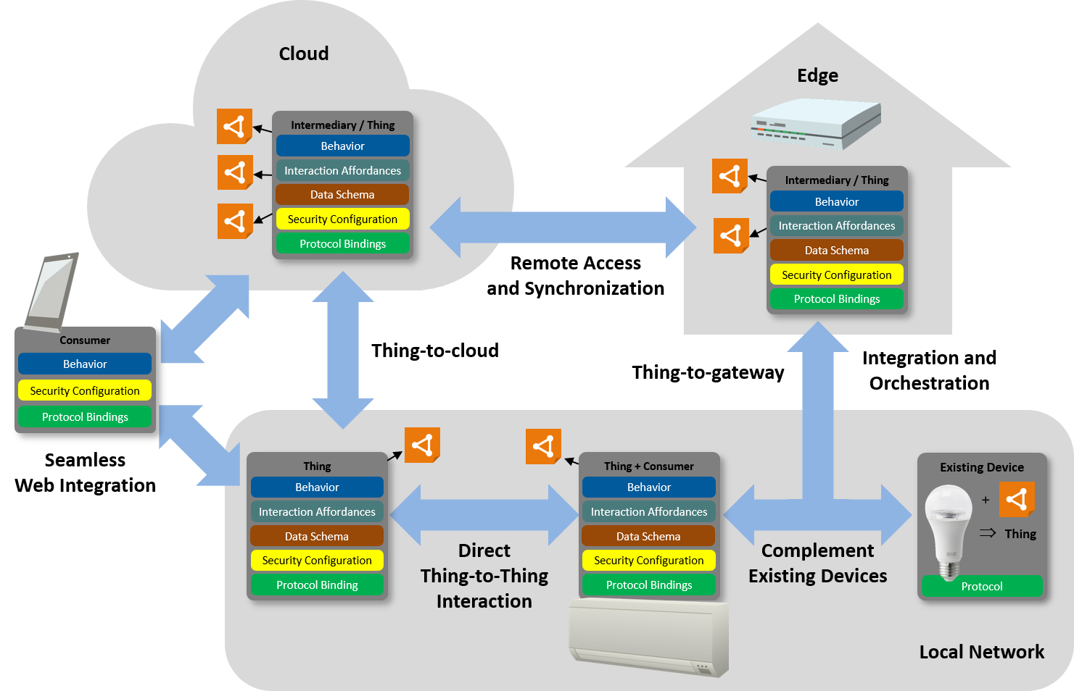
Abstract WoT Architecture

Slide 8
Interaction Model
Properties
Describe the state of a thing
Actions
Describe how to use a thing
Events
Enable a thing to communicate state changes

Slide 9
Hypermedia Controls
Links
Enable modeling relationships between things
Context
Relationship type
Link target and optional target attributes
Forms
Context
Operation type
Submission target
A request method

Slide 10
Building Blocks
Thing Description
Information model, semantic vocabulary, serialized representation JSON LD
Binding Templates
Blueprints for communication metadata
Scripting API
ECMA Script based API
Security and Privacy Guidelines
Cross-cutting security guidelines for each building block

Slide 11
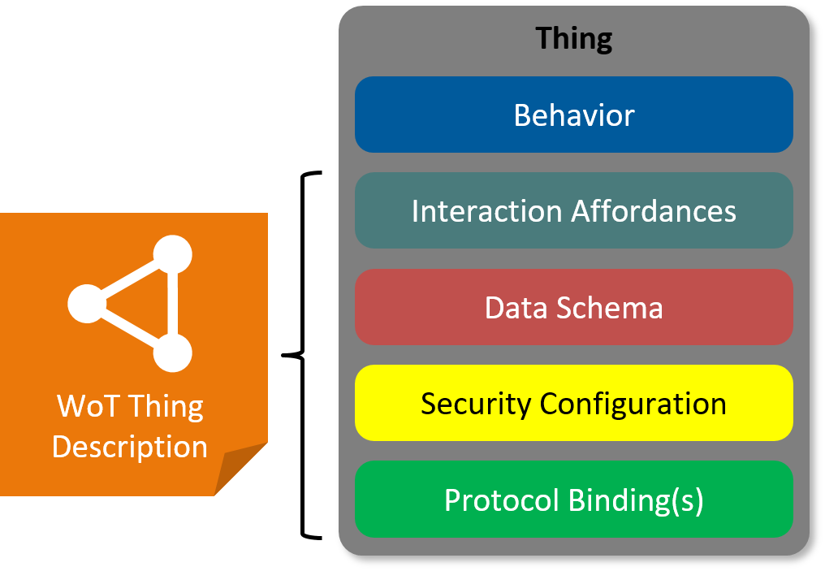
WoT Thing Description
WoT Thing Description describes several architectural aspects of a thing.
Thing description are used by consumers, who can interact with the thing, based on information in the TD.
A JSON-LD based serialisation format is defined in the Thing Description specification.

Slide 12
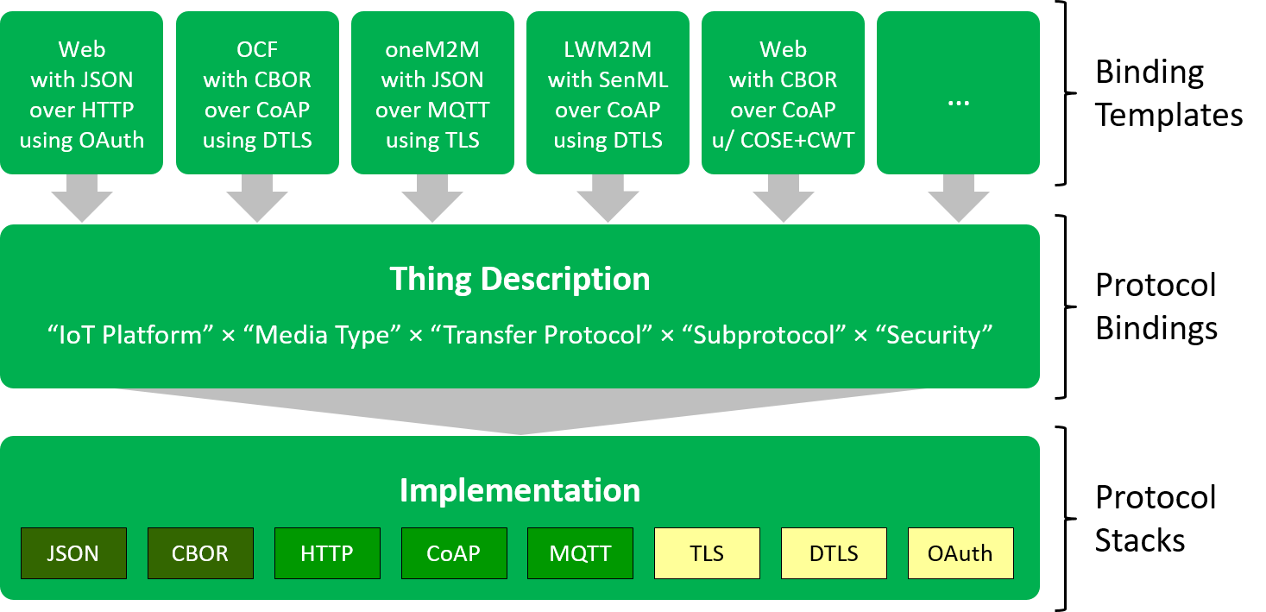
Protocol Bindings

Slide 13
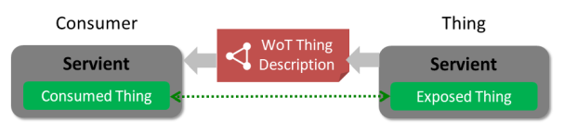
Direct Communication

Slide 14
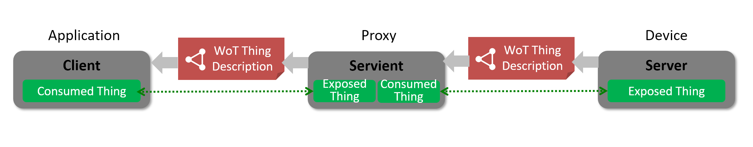
Indirect Communication

Slide 15
WoT Thing Description

Slide 16



The WoT Thing Description The index.html for Things
What kind of data do you serve?
Who are you?
How does the payload structure look like?
Are there some context information (e.g., unit)?
How can I access the data/function?
What kind of functions do you have?
What kind of protocols & serializations do you support?
Are there some security constrains?
Do you have other relations to other Things?

Slide 17


Describe Things with TDs
{ "@context": […], "@type": "Thing", "id": "urn:dev:ops:13473-temp-12", "title": "Temperature", "security": { "scheme": "basic" },
…. "properties" : { "value": { "type": "number", "minimum": "-40.2", "maximum": "48.4", "unit": "Celsius", "forms": [{ "href": “http://192.168.0.1/temp", "contenttype": "application/json"
}]}}}
{ "@context": [...], "@type": "Thing", "id": "urn:dev:ops:32473-robot-1", " title": "Robotic Arm", "security": { "scheme": "basic" },
…. "actions": { "openGrip": {...}, "closeGrip": {...}, "moveGripTo": {...} } }
{ "@context": […], "@type": "Thing", "id": "urn:dev:ops:42473-engine-12", "title": "Engine", "security": { "scheme": "oatuh2" },
…. "properties" : { "status": {...}, "speed": {...} }, "actions": { "onOff": {...} } }
{ "@context": […], "@type": "Thing", "id": "urn:dev:ops:53473-lamp-12", "title": "Lamp", "security": { "scheme": "basic" },
… "properties" : { "status": {...} }, "actions" : { "toggle" : {...} }, "events" : { "overheating" : {...} } }

Slide 18
WoT Thing Description – JSON-LD based Document Format
Thing
Metadata
{
"@context": [
"https://www.w3.org/2019/wot/td/v1",
{ "iot": "http://iotschema.org/" }
],
"@type": ["Thing"],
“title": "MyLEDThing",
"id": "urn:dev:ops:32473-WoTLamp-1234", "securityDefinitions": { "oauth2_sc": {"scheme": "oauth2", …}}
"security": ["oauth2_sc"],
"properties": {
"status": {
"@type": "iot:SwitchStatus",
"writeable": true,
"observable": true,
"type": "boolean", "forms": [ ... ]
}
},
"actions": {
"fadeIn": {
"@type": "iot:TurnOn",
"input": {
"type": {"type":"integer", "minimum": "0", "maximum": "5000"}
"@type": "iot:Duration",
"iot:Unit": "iot:MilliSeconds"
},
"forms": [ ... ]
}
},
"events": {
"criticalCondition": {
"@type": "iot:Alert",
"type": "string",
"forms": [ ... ]
}
},
"links": [
{ "href": "power-meter", "rel": "iot:Component", "type": "application/td+json" }
]
}
Security Metadata
List of Interactions
(~Services) w/ Data Schema
JSON Schema
vocabulary
Semantic annotation
Links (e.g., relations to other Things)
Protocol
Bindings

Slide 19
WoT Binding Templates

Slide 20
WoT Binding Templates – Instantiated in TDs
...
"properties": {
"brightness": {
... "forms": [
{ // Default: GET to read, PUT to write
"href": "https://myled.example.com:8080/pwr",
"contentType": "application/json"
}
]
}
},
"actions": {
"fadeIn": {
...
"forms": [
{
"href": "coaps://myled.example.com:5684/pwr",
"contentType": "application/ocf+cbor",
"coap:methodCode": 3, // PUT instead of POST to invoke
"coap:options": [ {
"coap:optionNumber": 2053, // OCF-Content-Format-Version
"coap:optionValue": "1.1.0"
} ]
}
]
Basics to build the request
Deviation from defaults
Notes:
coap:methodCode = PUT
coap:optionNumber 2053 = OCF-Content-Format-Version

Slide 21
WoT Scripting API

Slide 22
Scripting API standardization
In the WoT IG
Proposals
Discussed in weekly calls
Tested on plug-fests
In the WoT WG
GitHub repository
Proposals in GitHub issues
Several versions:
Editor’s Draft (ED)
First Public Working Draft (FPWD)
Working Draft (WD)
WG Note
Initial ED: February 2017
FPWD: 14.09.2017
WD1: 05.04.2018
WD2: 29.11.2018
WG Note: June 2019 (work can continue)
Reference implementation: node-wot

Slide 23
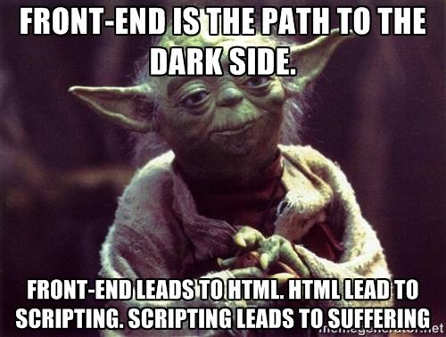
Why a Scripting API?
https://i.redd.it/trf1qch4ywi01.jpg
Notes:
https://i.redd.it/trf1qch4ywi01.jpg

Slide 24
Why a Scripting API
Scripting has transformed the Web
Marc Andreessen, the founder Netscape, “believed that HTML needed a ‘glue language’ that was easy to use by Web designers and part-time programmers to assemble components such as images and plugins, where the code could be written directly in the Web page markup.”
Brendan Eich wrote Java-inspired Mocha in 10 days in May 1995
Later called LiveScript, then JavaScript, then standardized as ECMAScript
10.7 million JavaScript developers in 2018 (out of 23 million)
WoT describes and integrates IoT platforms through Web technologies
addressing, discovery, access control, data transfer, and
scripting.

Slide 25
Scripting API
Web page → Thing
URL → URI
HTTP → HTTP, CoAP, BLE, WS
HTML → Thing Description
ECMAScript → WoT Script
Web search → Discovery
Served page → Exposed Thing
Rendered page → Consumed Thing

Slide 26
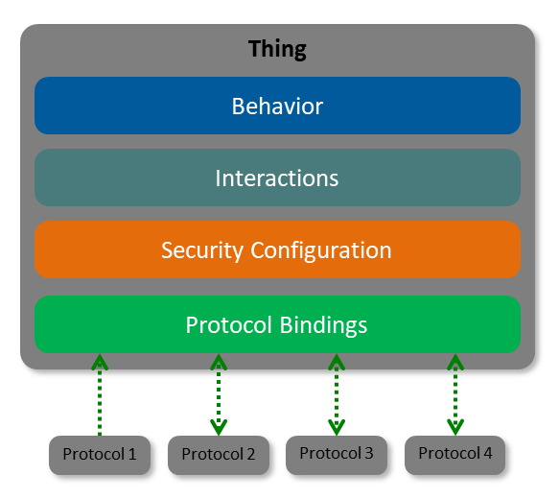
Scripting API place in WoT architecture
Thing Description (TD)
Metadata describing the data model, security & interactions.
Thing
Runtime
Scripting API
A standardized API to control Thing interactions and implement behaviour.
App Script
Scripting API
Interactions
Protocol Bindings
Describes how to translate WoT interactions to the underlying protocols.
Security
Protocol Bindings
Security & Privacy
Ensures that all building blocks provide means to describe the security and privacy mechanisms used in underlying platforms.

Slide 27
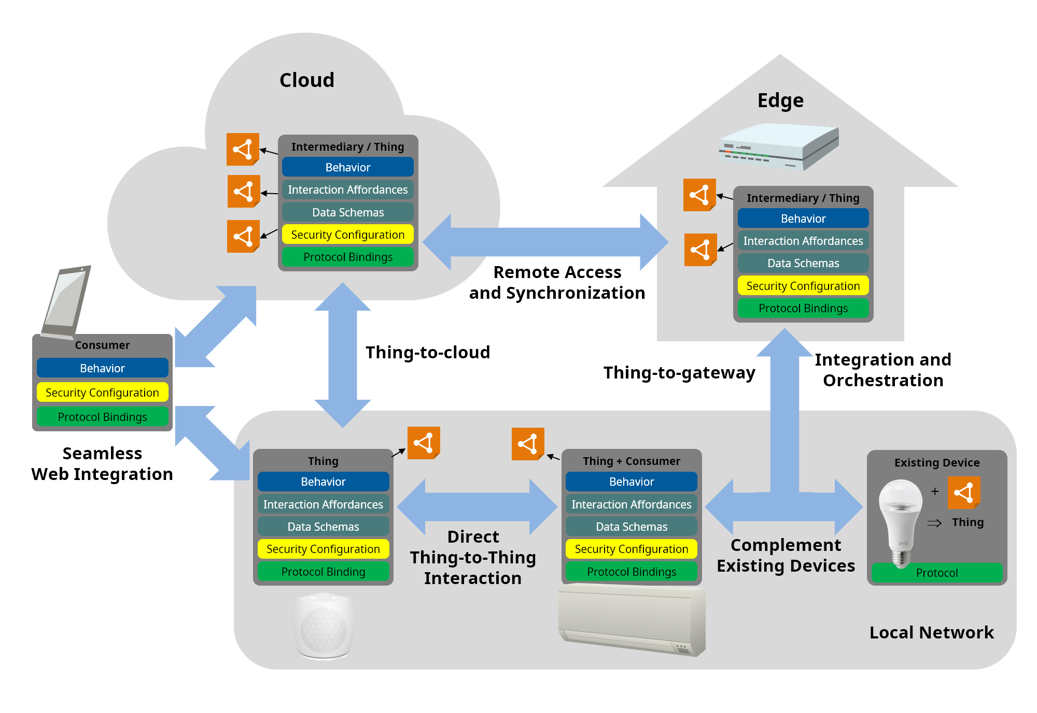
Scripting API use cases

Slide 28
Approaches to the Scripting API
No externally exposed API (only WoT network interface) | A WoT gateway can encapsulate other IoT deployments: presents a REST-ful API towards clients implements IoT protocols towards IoT deployments
Simple API lock = WoT.consume(‘https://td.my.com/lock’); print(lock.status); lock.open(); | Thing = object Thing Property = object property Thing Action = object method Thing Event = event WoT API object = lifecycle methods
Current API (based on the TD spec) lock = WoT.consume(‘https://td.my.com/lock’); print(lock.readProperty(‘status’)); lock.invokeAction(‘open’); | Thing Description = data object Thing = TD instance + API methods WoT API object = lifecycle methods

Slide 29
WoT Security and Privacy Guidelines

Slide 30
Security and Privacy Guidelines
Security and Privacy Considerations sections in each of the Architecture and Thing Description documents
Metadata supporting security mechanisms in TD
Can be easily extended with vocabulary extensions
Delivered separate document: Security and Privacy Guidelines Note
Covers threat model, risks, and mitigations
Testing plan including adversarial testing
Previously Security and Privacy Considerations + Security Testing Plan, content to be merged and published as a single Note
Work in Progress: Security and Privacy Best Practices

Slide 31

Contact
Kazuyuki Ashimura
W3C Staff
Web of Things Team Contact
ashimura@w3.org
team-wot@w3.org

Slide 32
<For Color Picking>
Properties
WoT Security Guidelines
Overarching security and privacy guidelines with the prudence level of the World Wide Web
Actions
Events
WoT Thing Description
Web Things
WoT Architecture
WoT Scripting API
Information model and representation format for rich semantic metadata
“The HTML for Things”
JavaScript environment similar to Web browser APIs, but for IoT applications
WoT Binding Templates
Include existing ecosystems

Slide 33
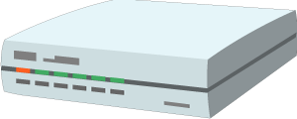



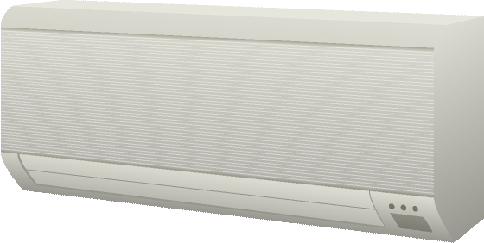
<For Color Picking>
Cloud
Edge
Intermediary / Thing
Behavior
Interaction Affordances
Intermediary / Thing
Data Schemas
Behavior
Security Configuration
Interaction Affordances
Protocol Bindings
Remote Access and Synchronization
Data Schemas
Security Configuration
Protocol Bindings
Consumer
Thing-to-cloud
Integration and Orchestration
Behavior
Thing-to-gateway
Security Configuration
Protocol Bindings
Seamless
Web Integration
Thing
Thing + Consumer
Existing Device
Behavior
Behavior
+
Interaction Affordances
Interaction Affordances
⇒
Data Schemas
Direct Thing-to-Thing
Interaction
Data Schemas
Complement Existing Devices
Thing
Security Configuration
Security Configuration
Protocol Binding
Protocol Bindings
Protocol
Local Network

Slide 34
<For Color Picking>
Thing
Behavior
Interaction Affordances
Data Schemas
WoT Thing Description
Security Configuration
Protocol Binding(s)

Slide 35
<For Color Picking>
Servient
Exposed
WoT Thing Description
Application Script
Behavior Implementation
General Metadata
Consumed
Interaction Affordances
Scripting WoT Runtime
WoT Thing Description
Data Schemas
Public Security Configuration
WoT Scripting API
Protocol Binding(s)
Exposed Thing
Consumed Thing
Consumed Thing
…
WoT Thing Description
Binding Templates
Private Security Configuration
Protocol Stack Implementation
System

